Slide 1
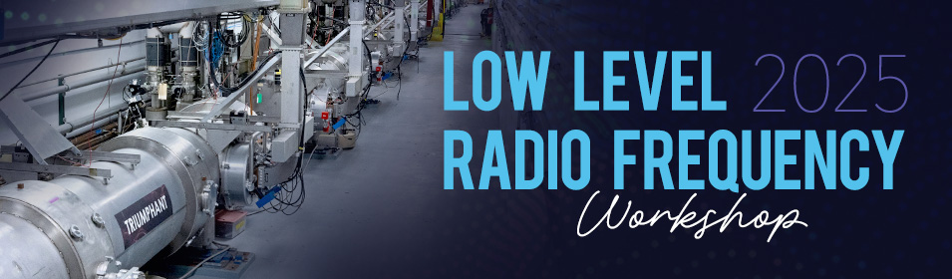
A Universal Cavity Controller for testing SRF cavities at CERN
D. Barrientos, L. Balocchi, K. Brunner, K. Geis, A. Macpherson, L. Millar, N. Stapley, T. Wlostowski
14/10/2025

Slide 2
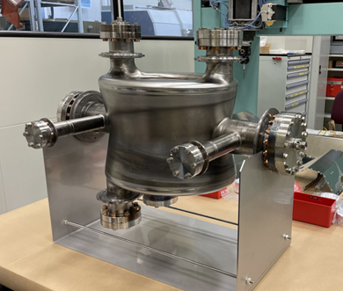
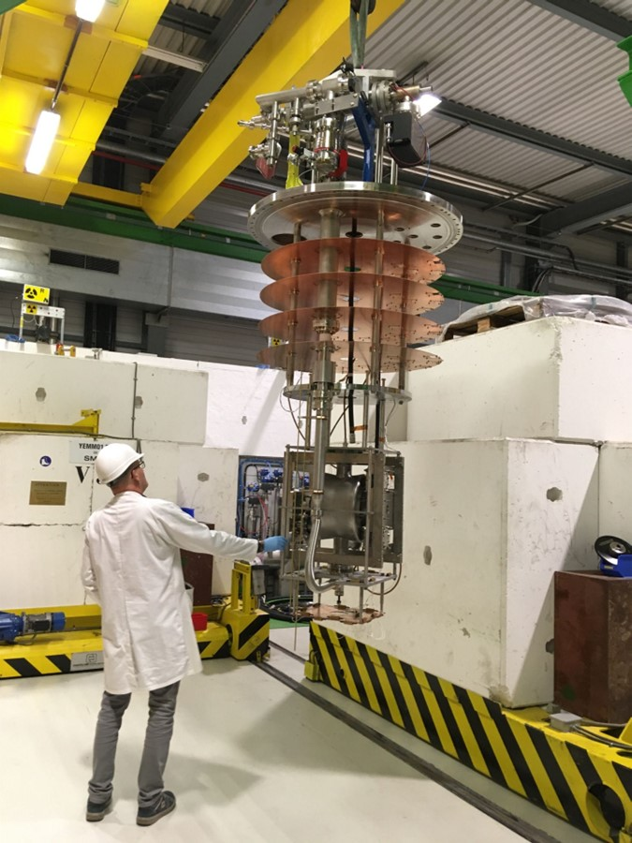
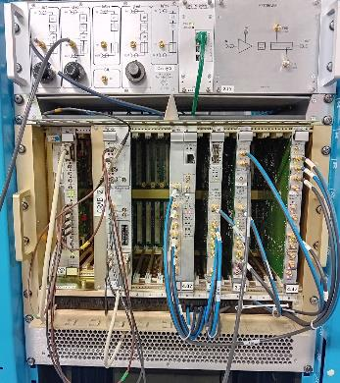
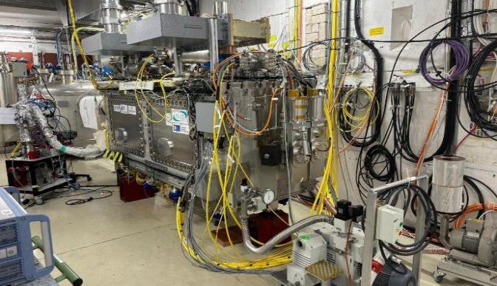
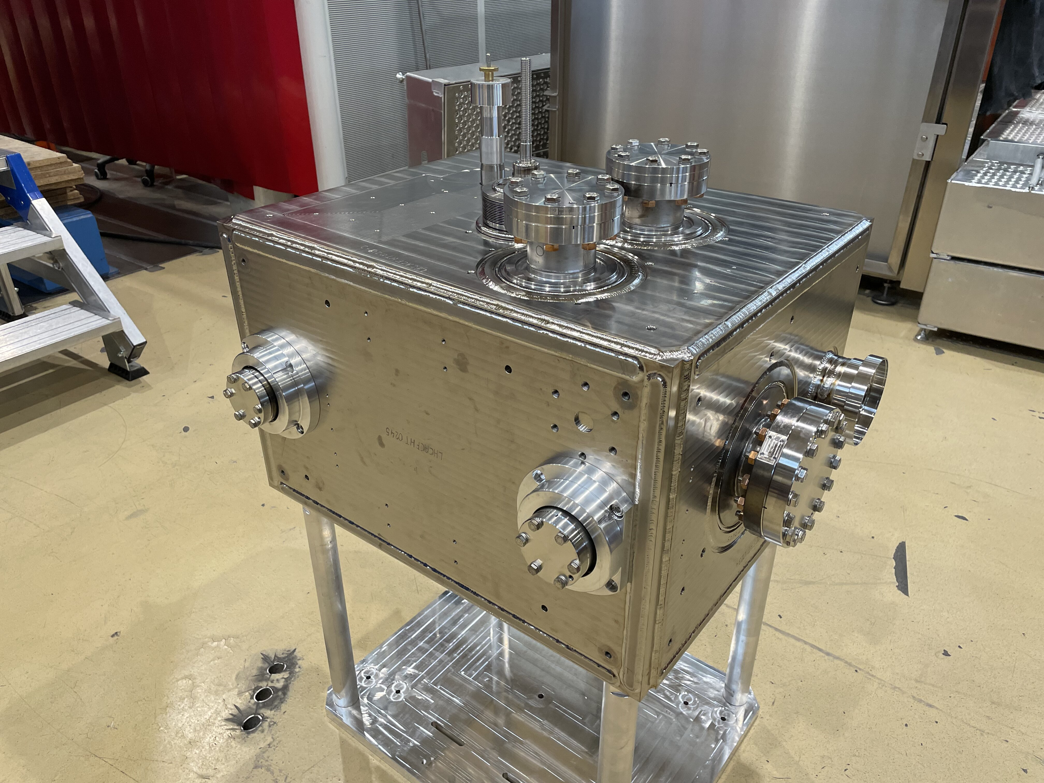
Motivation
Development and validation of SRF Cavities
Purpose: Measurement of high quality factor SRF cavities (Q0 in 10⁸ - 10¹¹ range)
CERN has a variety of cavities with frequencies ranging from 101 -1300 MHz
LLRF framework must be adaptable to any given cavity type and specific R&D needs
Cavity validation
LLRF example system
Cryomodule validation
Images courtesy of HL-LHC WP4 – Crab Cavities

Slide 3
Motivation
Development and validation of SRF Cavities
Context: LLRF must follow cavity testing as they progress through their preparation cycle
RF measurement from bare cavities to beam-ready cryomodules
Cavity validation
LLRF example system
Cryomodule validation
Images courtesy of HL-LHC WP4 – Crab Cavities

Slide 4
Motivation
Development and validation of SRF Cavities
Requirement: Common architecture to ensure coherence across measurement campaigns
Measurements include both pulsed and continuous powering operational modes
Self-Excited Loop and Generator Driven modes required
Cavity validation
LLRF example system
Cryomodule validation
Images courtesy of HL-LHC WP4 – Crab Cavities

Slide 5
System architecture

Slide 6
System architecture
LLRF cavity controller standardization

Slide 7
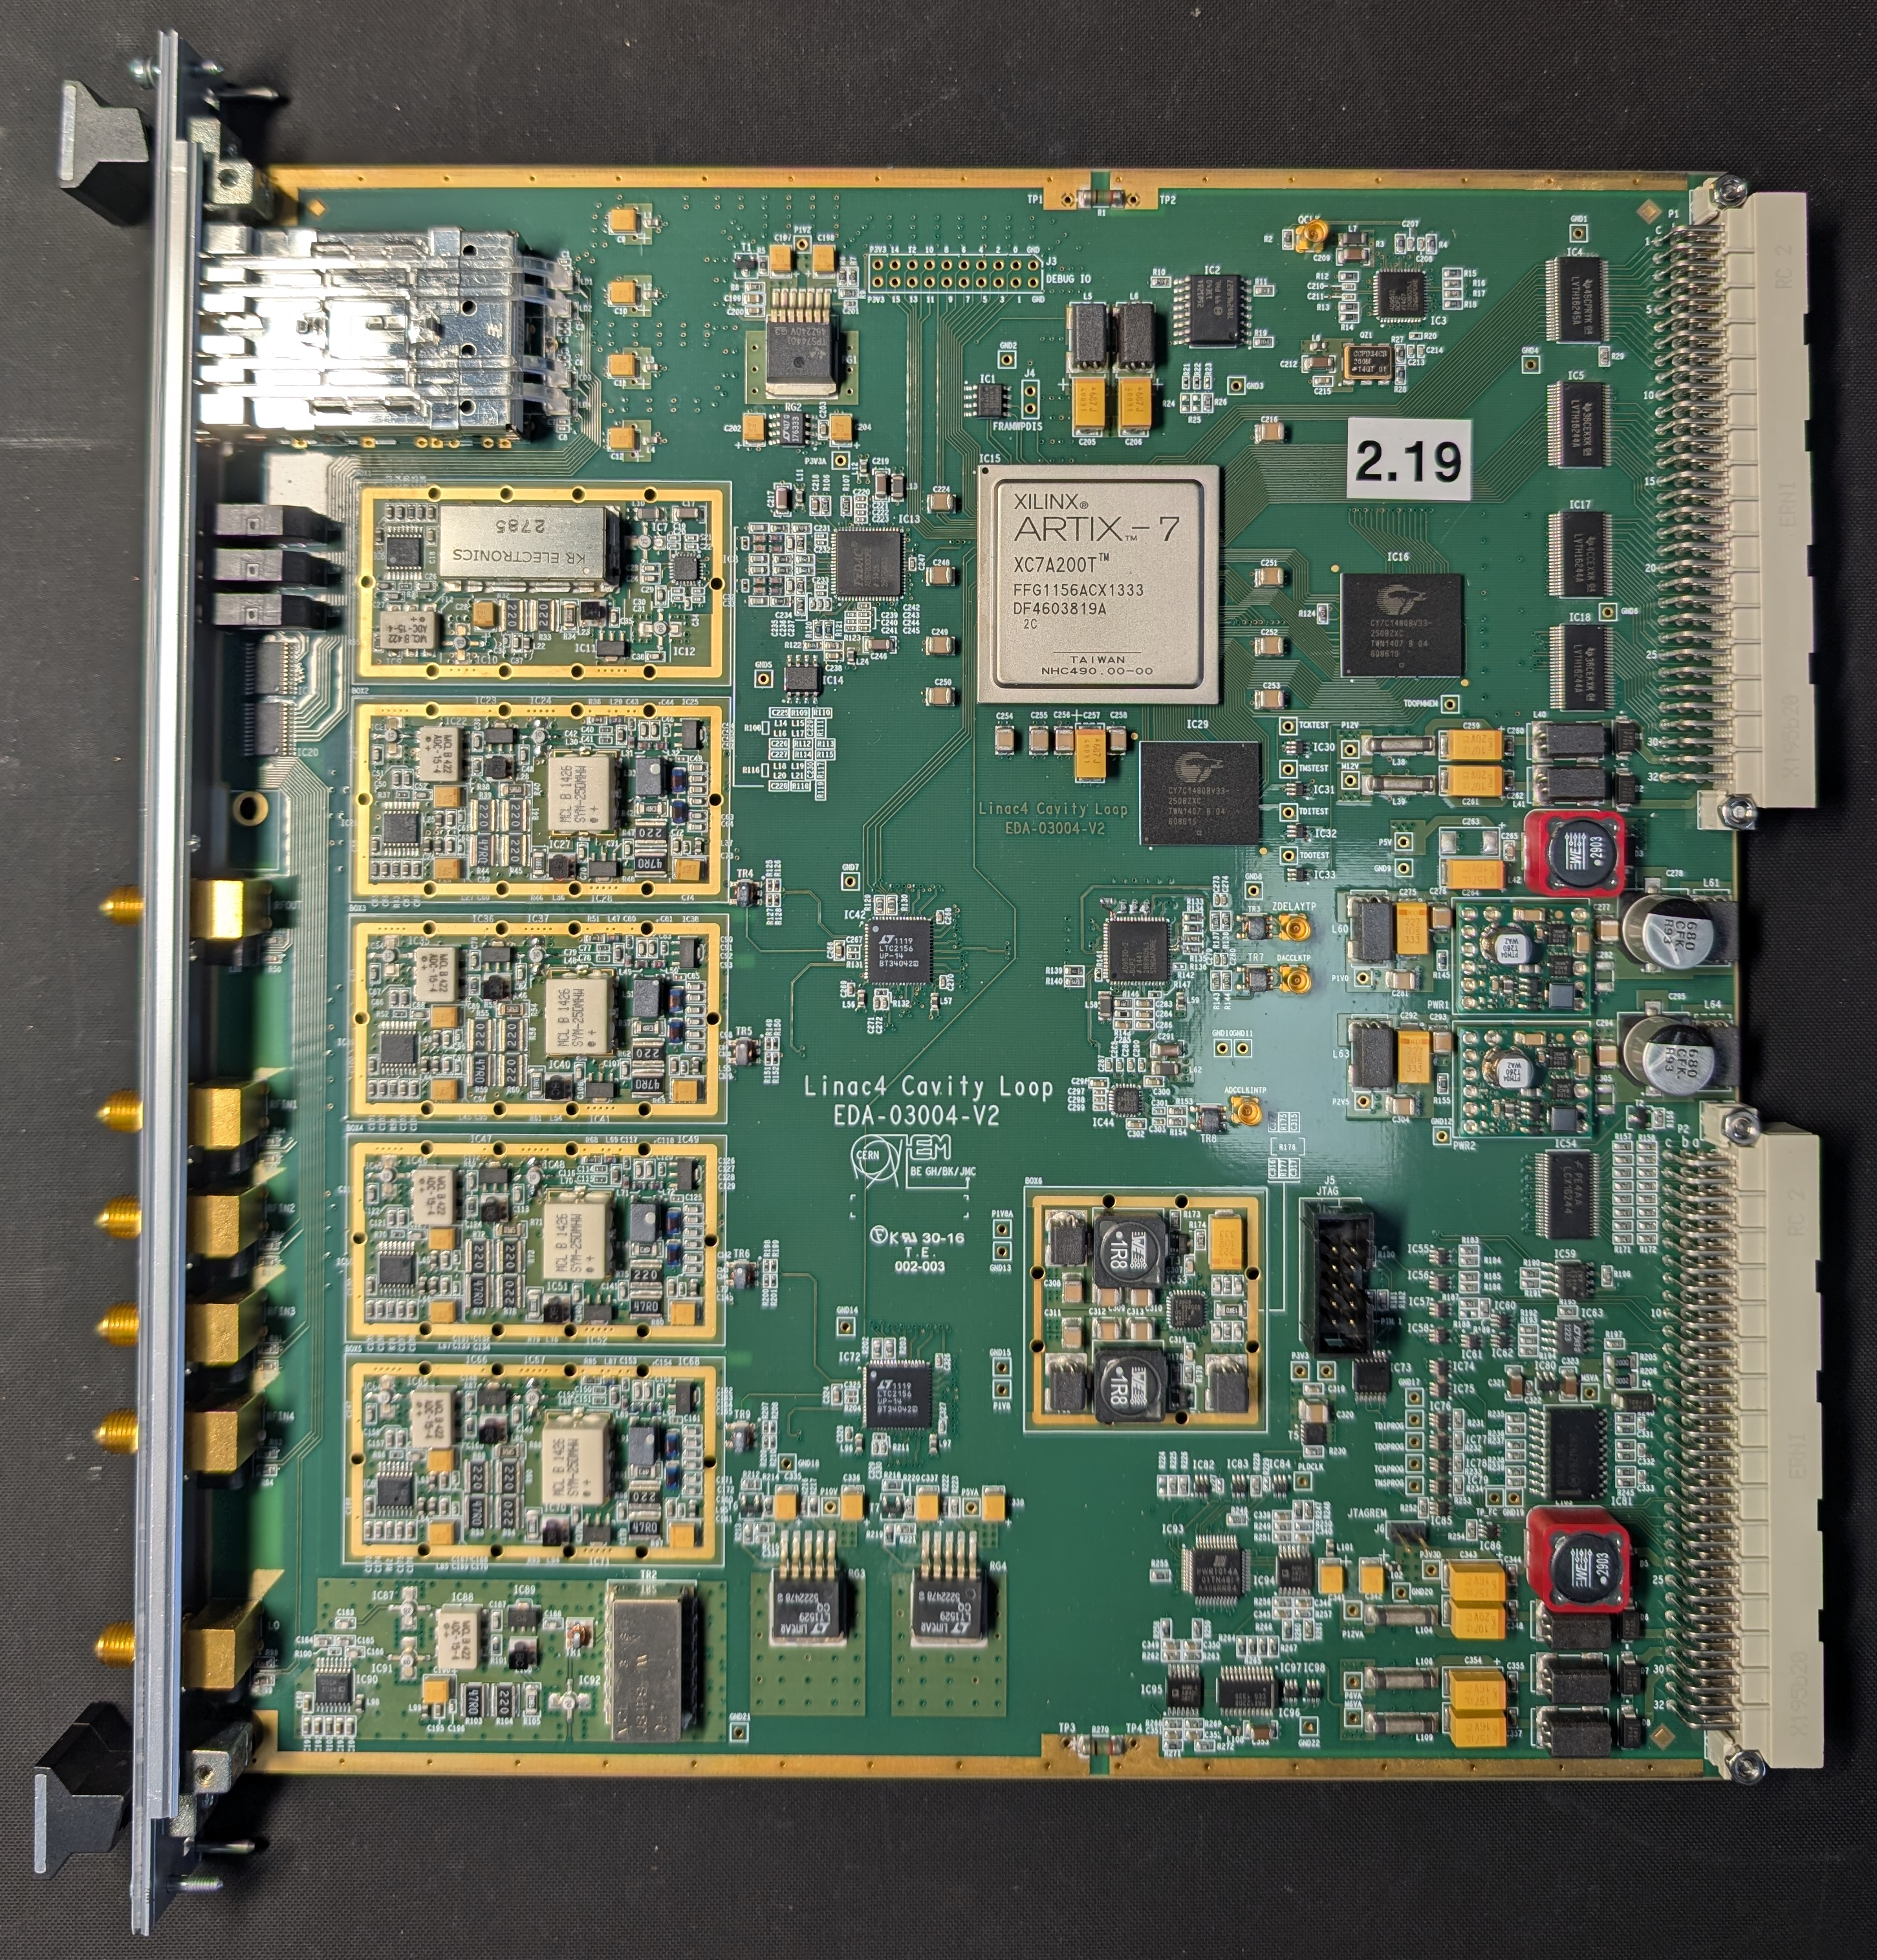
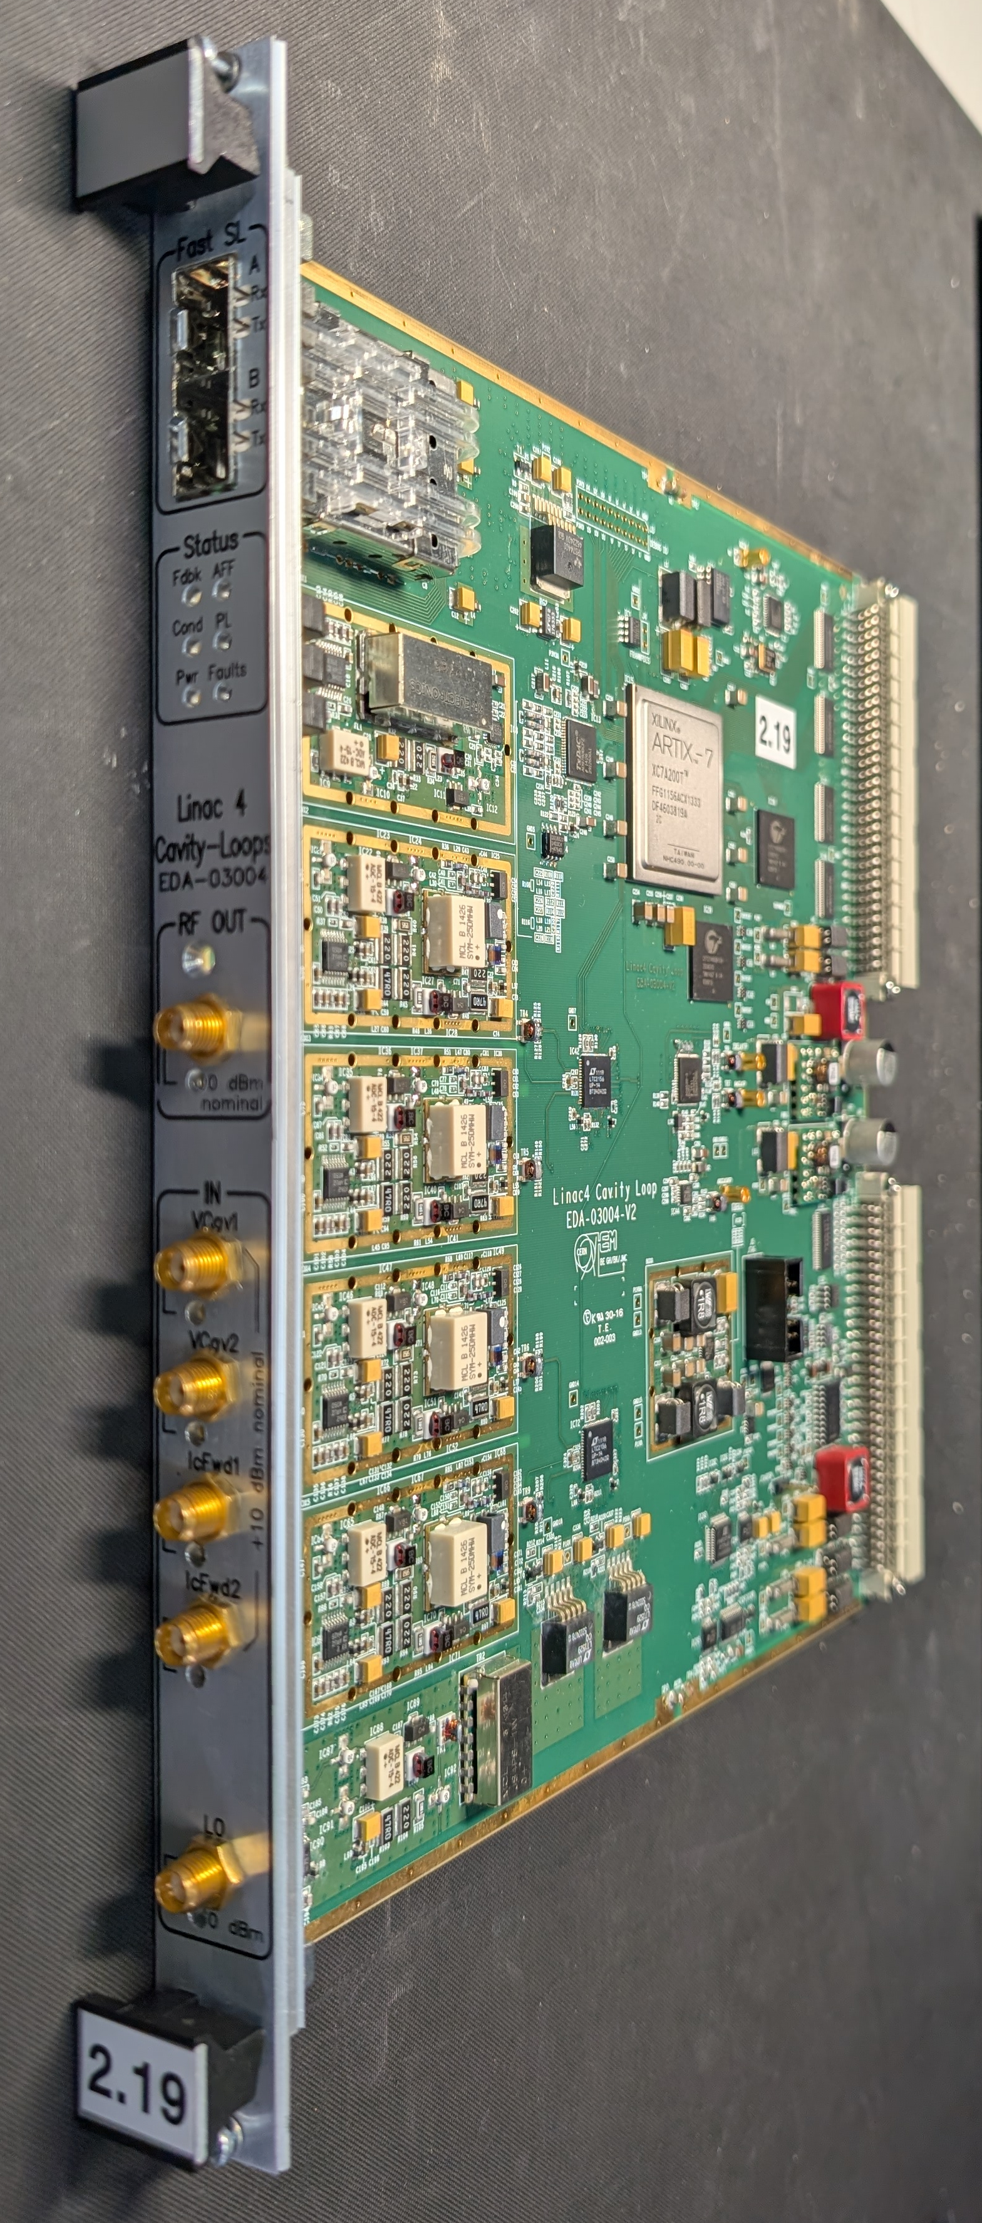
Hardware
Artix-7 FPGA
2x SFPs
(up to 2.5 Gbps)
PCI Express
VME A24/D16
16-bit IQ DAC +
Vector modulator
(BW = 25 MHz)
16 MB SSRAM
4 input channels
14-bit ADCs
(BW = 25 MHz)
Clock,
triggers…
LO distribution
(200 MHz – 1.5 GHz)

Slide 8
Software
CERN standard setup
Reusing control applications layer
Easy integration into CERN controls system
Encapsulation of hardware related operations in low-level library
Code generation for driver and FPGA registers layers

Slide 9

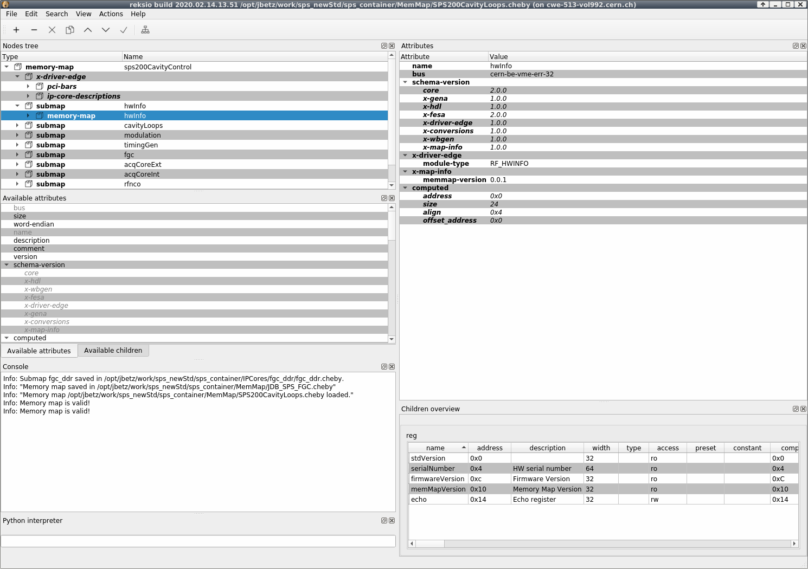
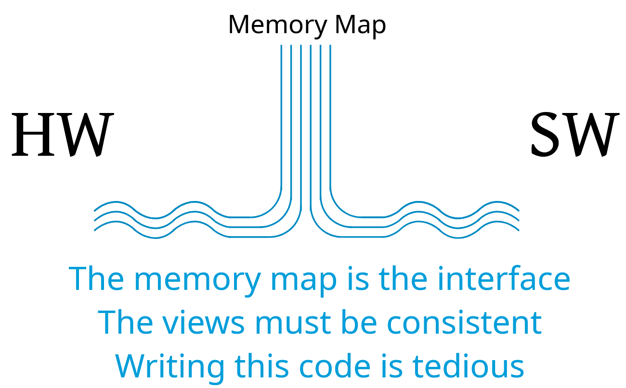
Reksio (& cheby)
Create memory map with a graphical tool. Verify correctness
Use code generators for HDL and C++ driver wrapper, FESA class skeleton
Quick development/testing using Python
Open-source tools
T. Gingold, B. Bielawski - FPGA Developers’ Forum 2025, CERN

Slide 10
UCC architecture
Hardware independent architecture
Reusability
Standard blocks and processes

Slide 11
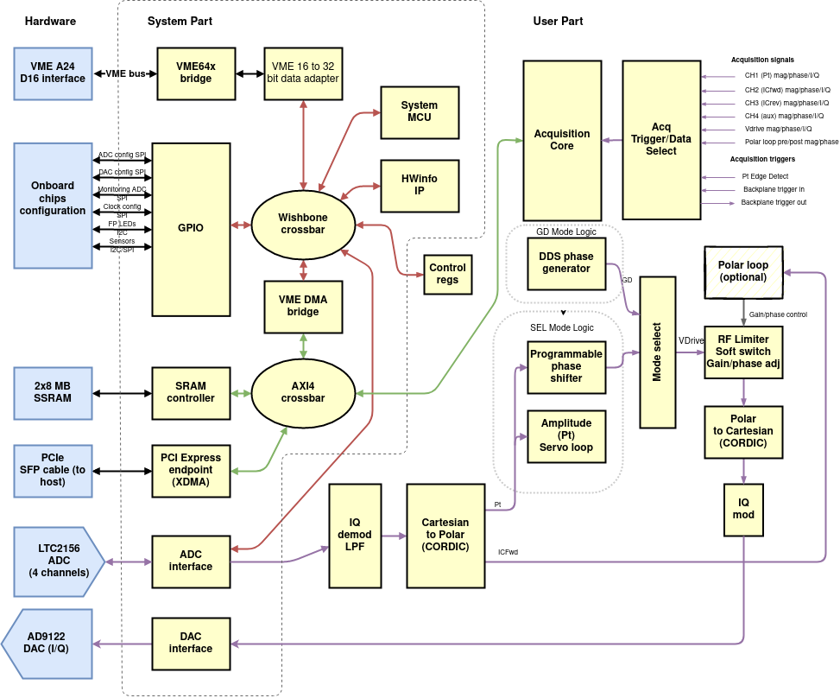
UCC architecture

Slide 12
UCC architecture

Slide 13
UCC architecture

Slide 14
UCC architecture

Slide 15
UCC architecture

Slide 16

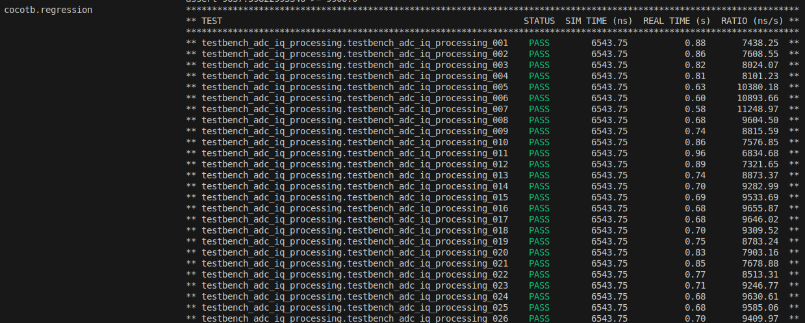
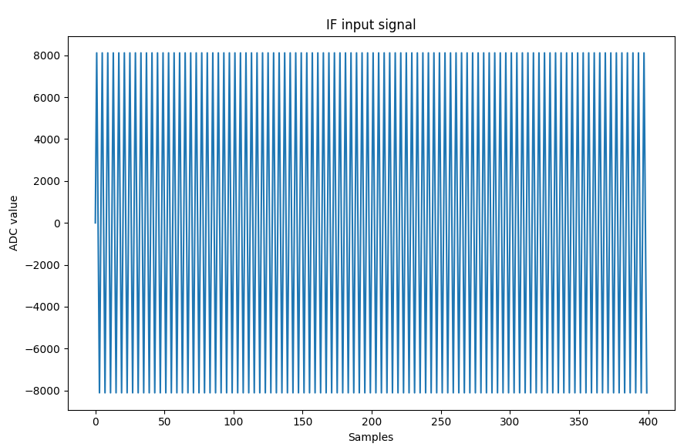
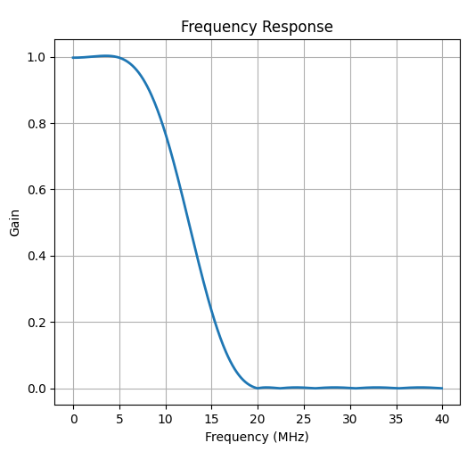
Ease development
Example:
Generate IF data with different attenuation, phase offset, frequency.
Model demodulation, low-pass-filter, CORDIC
Check magnitude, phase, frequency

Slide 17
UCC architecture

Slide 18
UCC architecture

Slide 19
UCC architecture
T. Wlostowski et al. – ICALEPCS 2015, Melbourne, Australia

Slide 20
UCC architecture
Hardware independent architecture
Reusability
Standard blocks and processes
System/user parts
MCU
IP cores + shared libraries
Continuous Integration

Slide 21
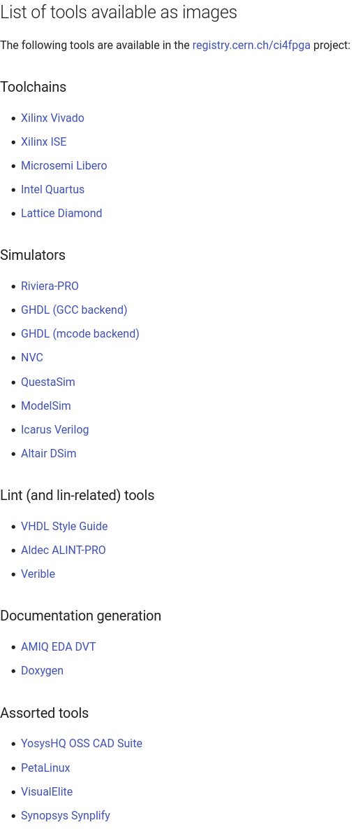
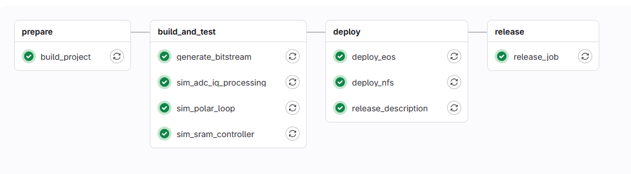
Continuous Integration (CI)
Simulation, implementation, generation
CI4FPGA service at CERN
Scalable VM-based k8s clusters
Easy-to-use Docker images
Comprehensive documentation
C. Gentsos - FPGA Developers’ Forum 2025, CERN

Slide 22
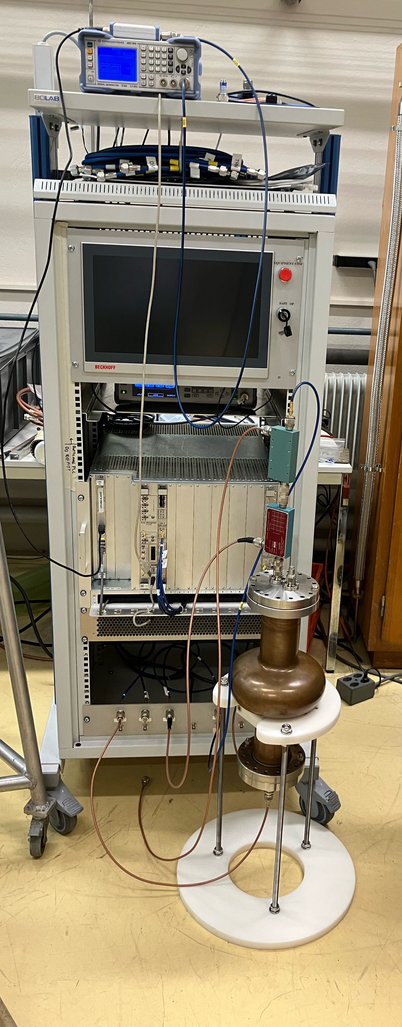
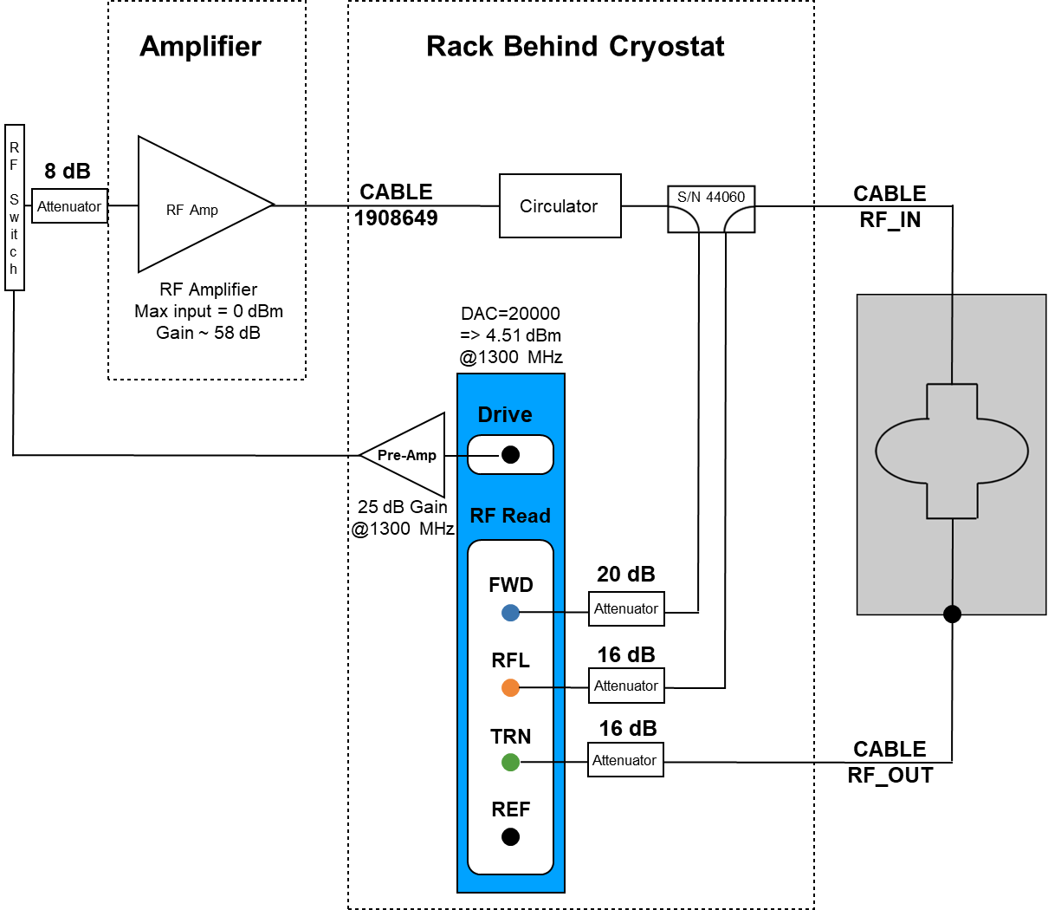
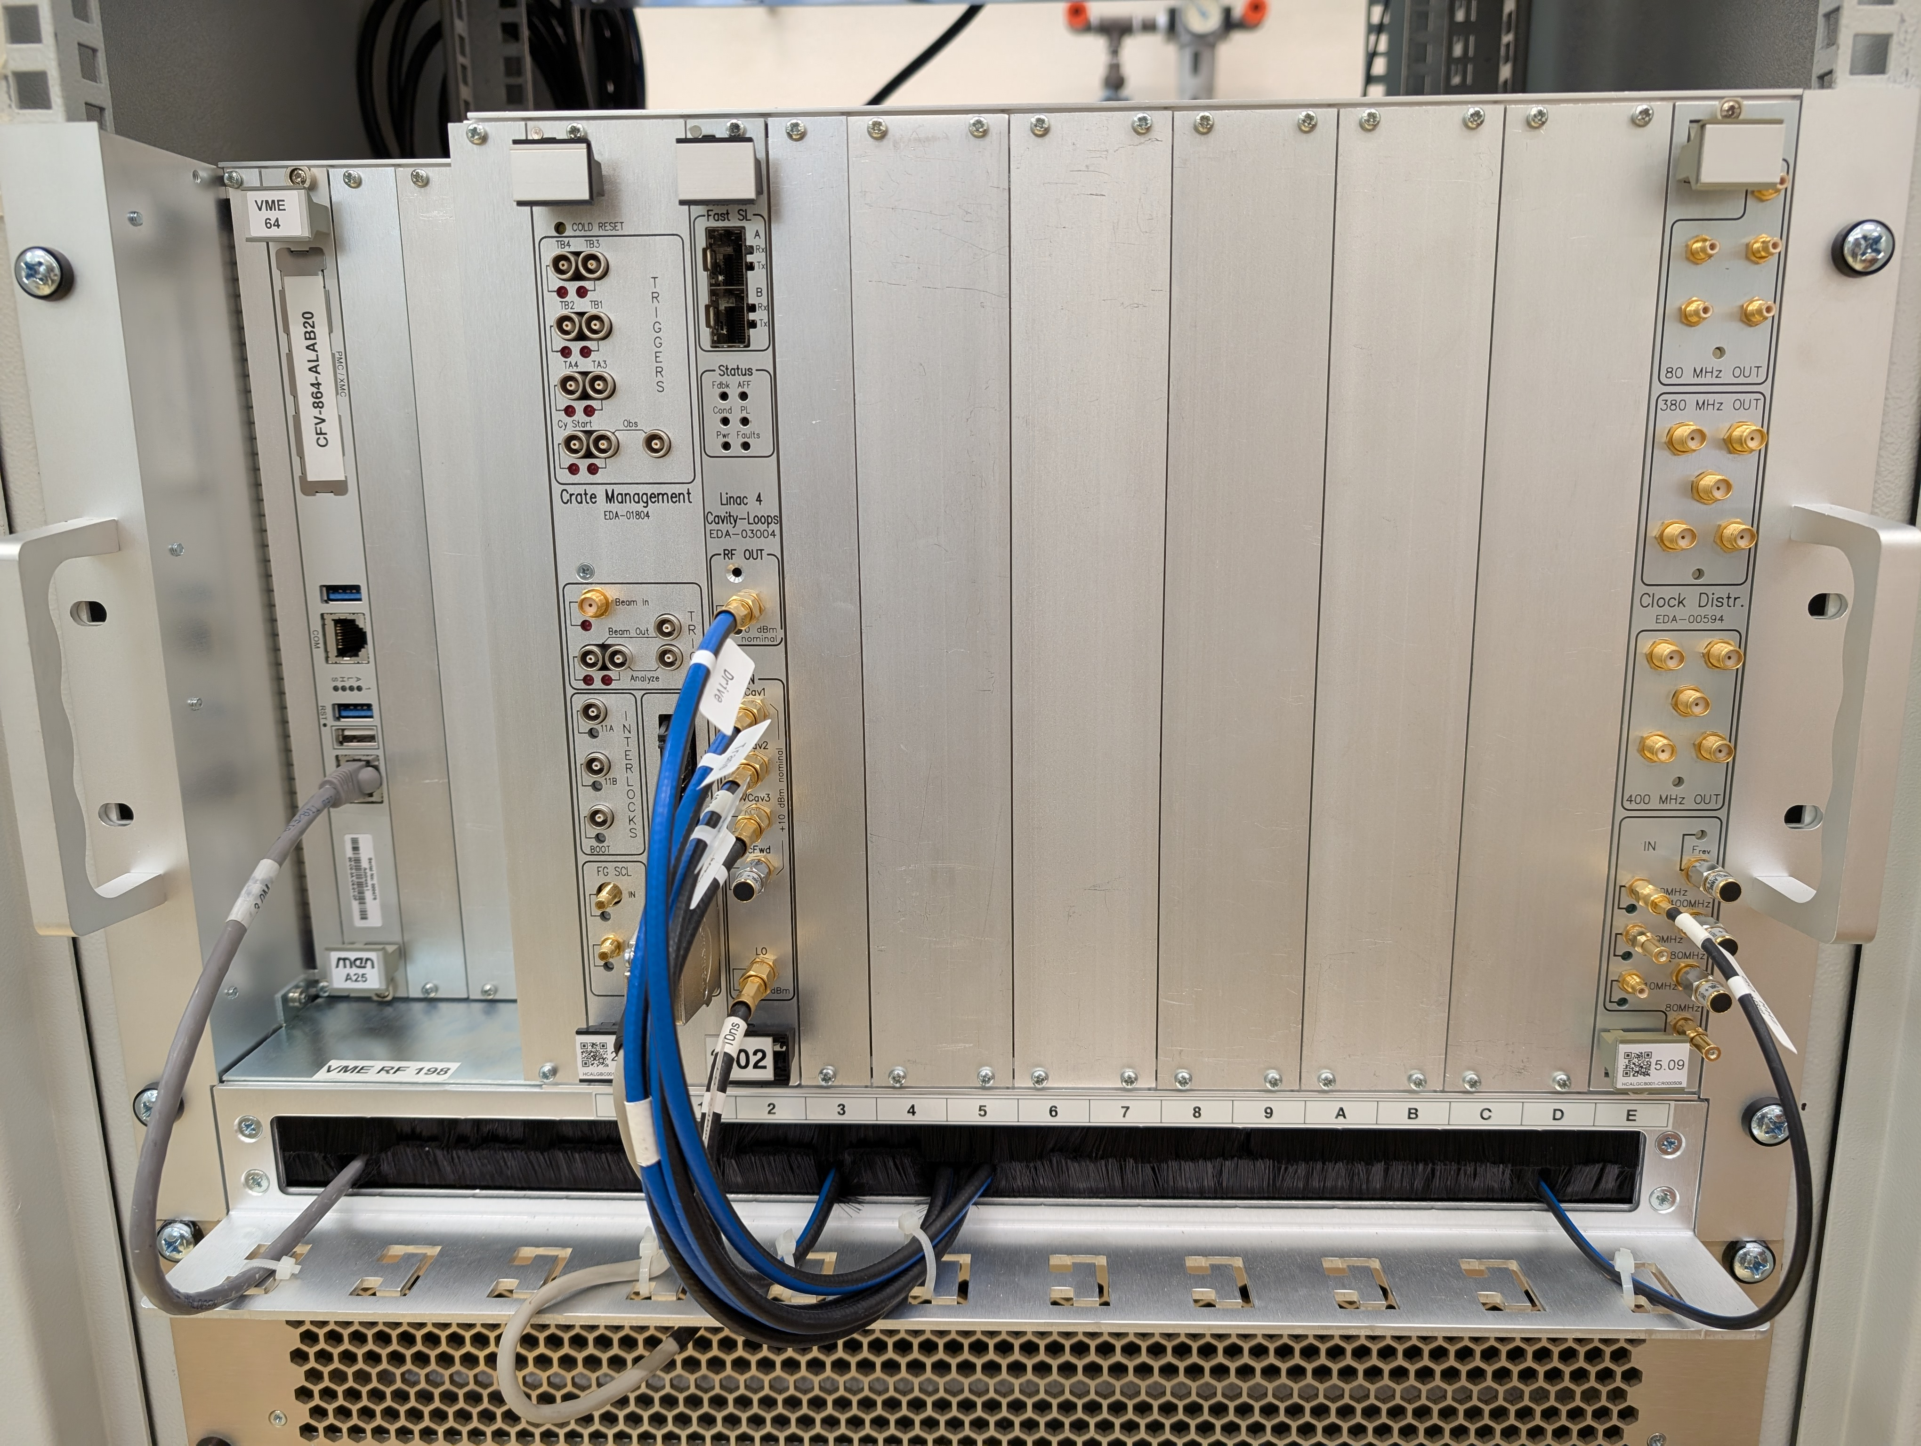
Cavity tests
Tests setup installation
Gradual deployment into all SRF test systems
Mobile development setup

Slide 23
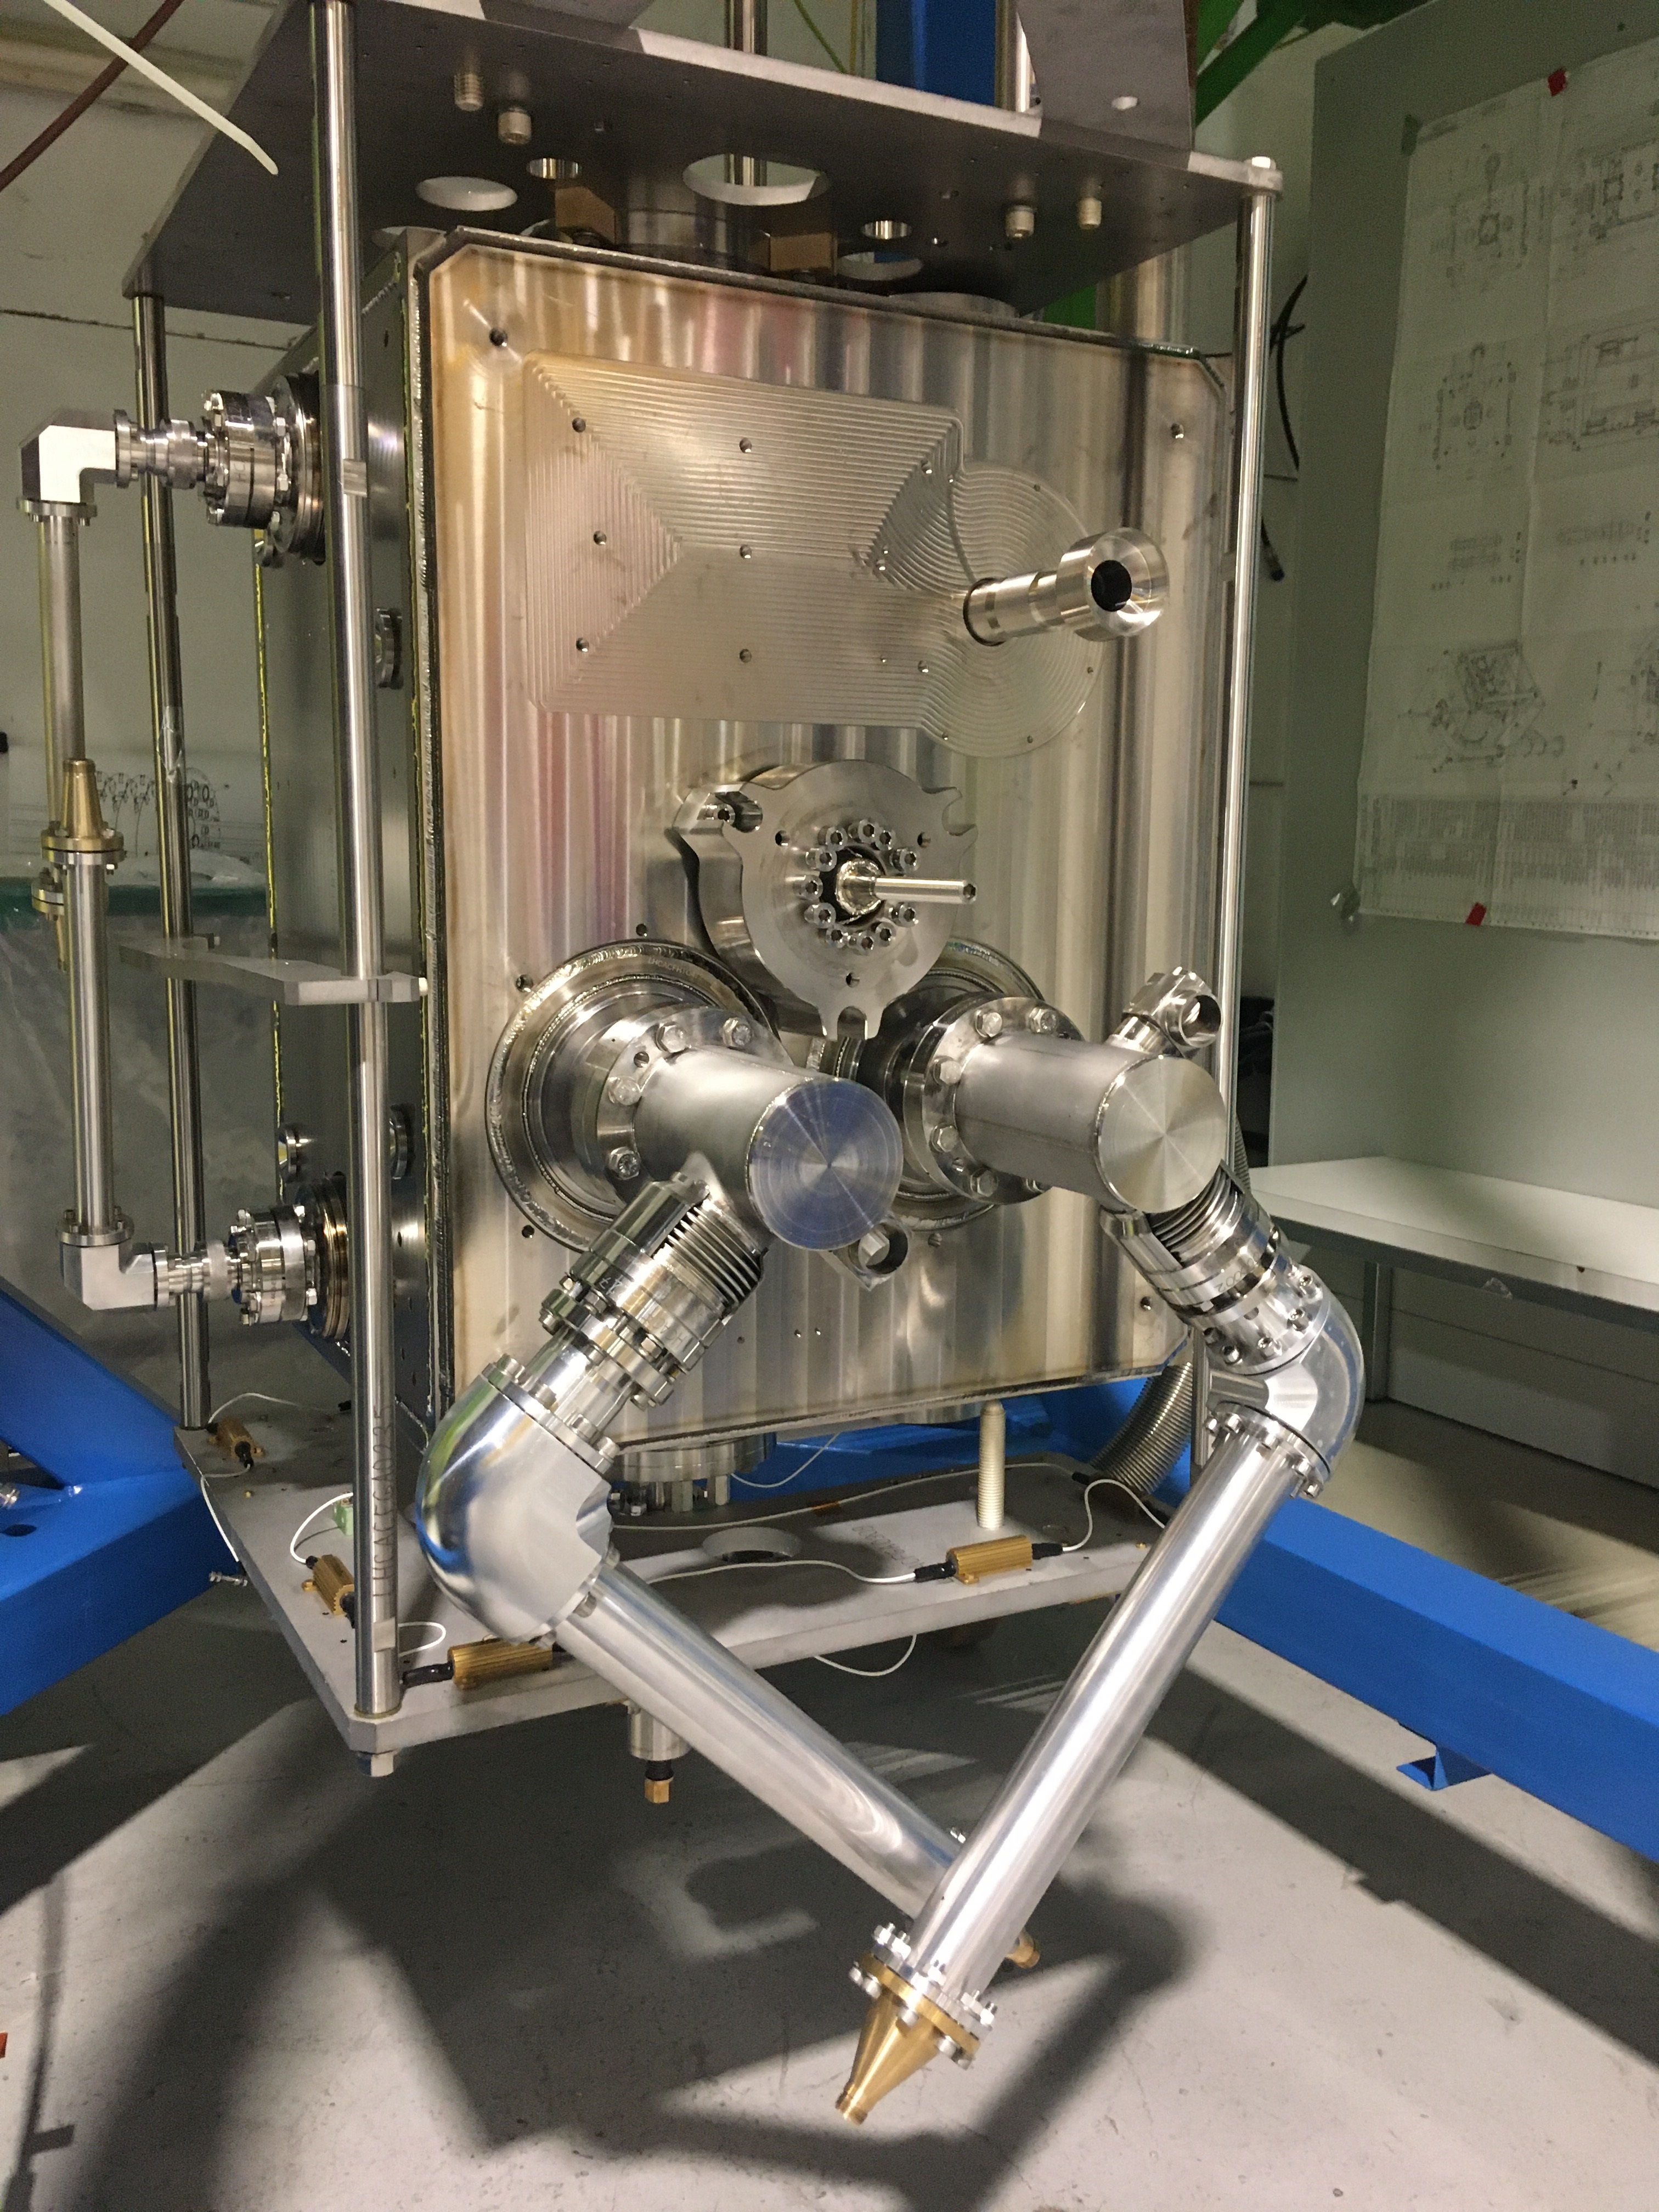
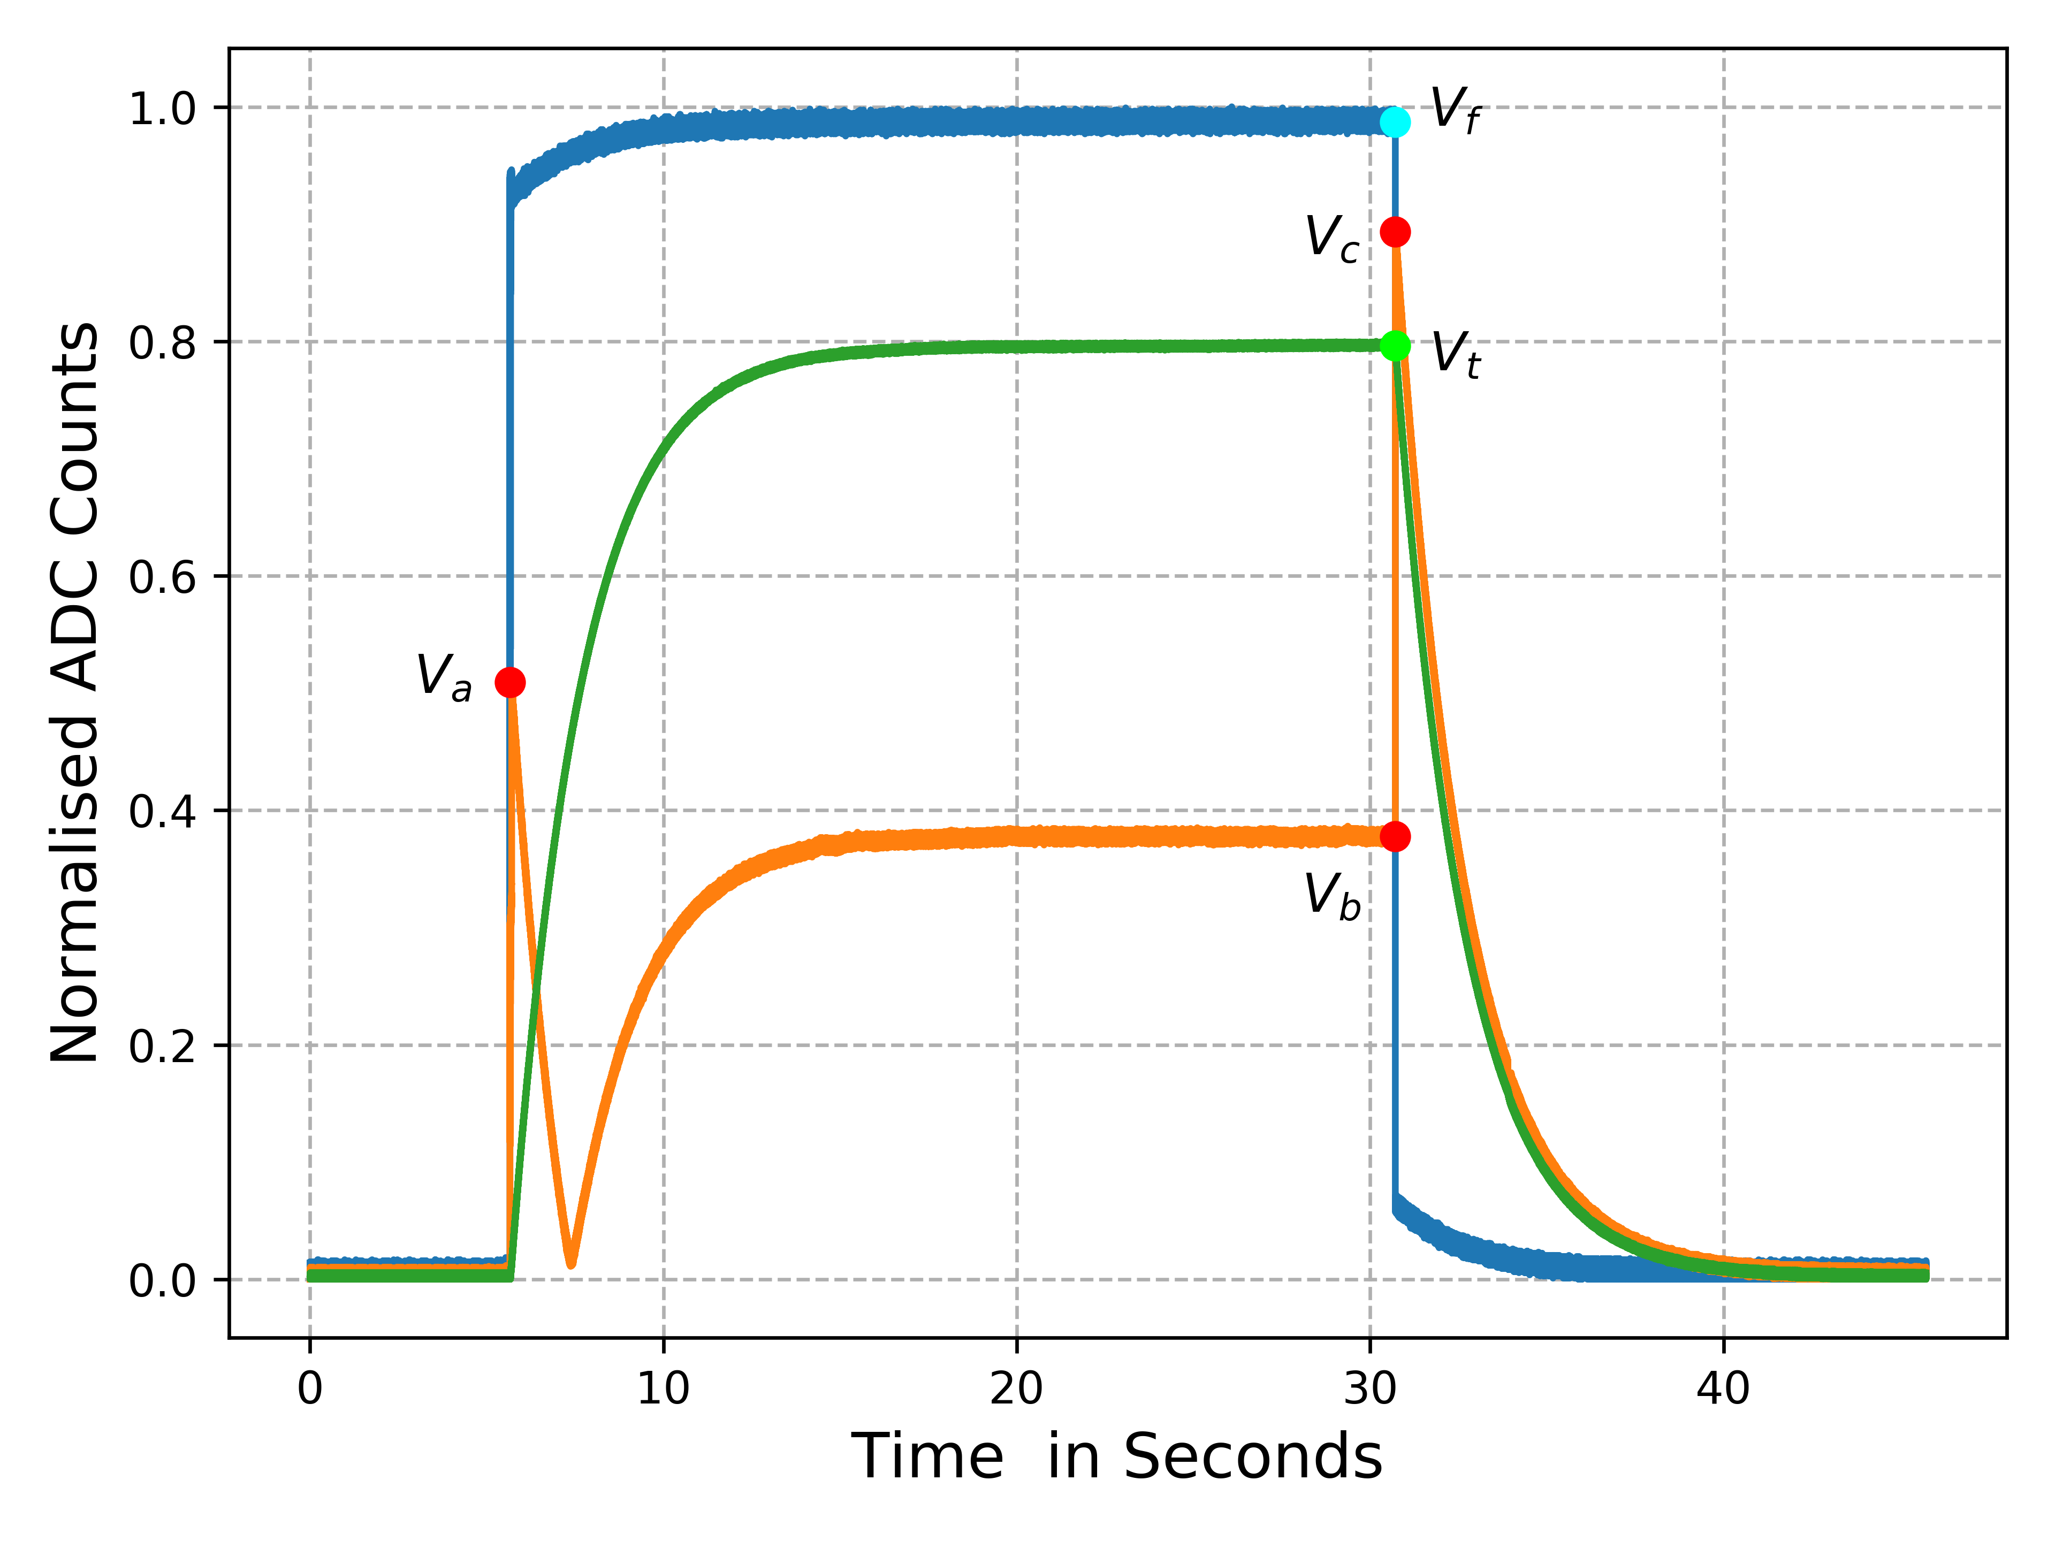
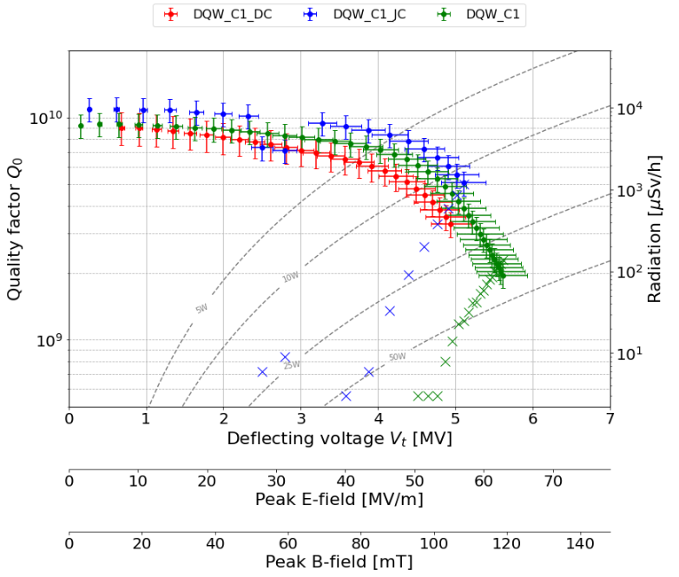
Cavity tests
Recent 400 MHz Crab cavity
performance validation campaign
Self-Excited Loop: Typical pulse measurement
FWD
TRN
RFL
Courtesy of HL-LHC WP4 – Crab Cavities
Courtesy of HL_LHC WP4 - Crab Cavities

Slide 24
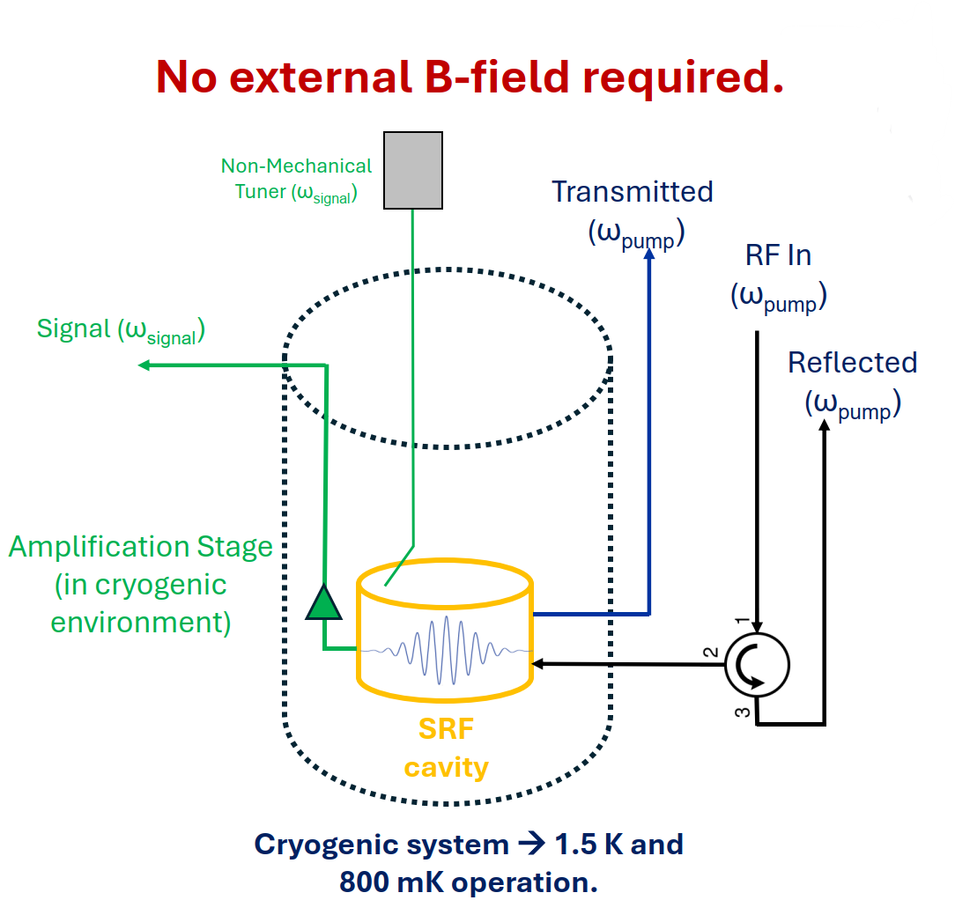
Future challenges: Axion detection
Heterodyne approach:
Drive a high-Q cavity at a frequency, ω_{pump}.
Axion interacts with cavity field and transfers energy to a second mode at ω_{signal}.
Monitor ω_{sig}, the axion mass is given by the frequency difference (Δω= ω_{pump} - ω_{signal}).
Mass range can be scanned by varying Δω → tuning system.
Initial tests in Q1 2026
L. Millar et al. – 22nd International Conference on RF Superconductivity (SRF2025), Tokyo, Japan

